Slide 1
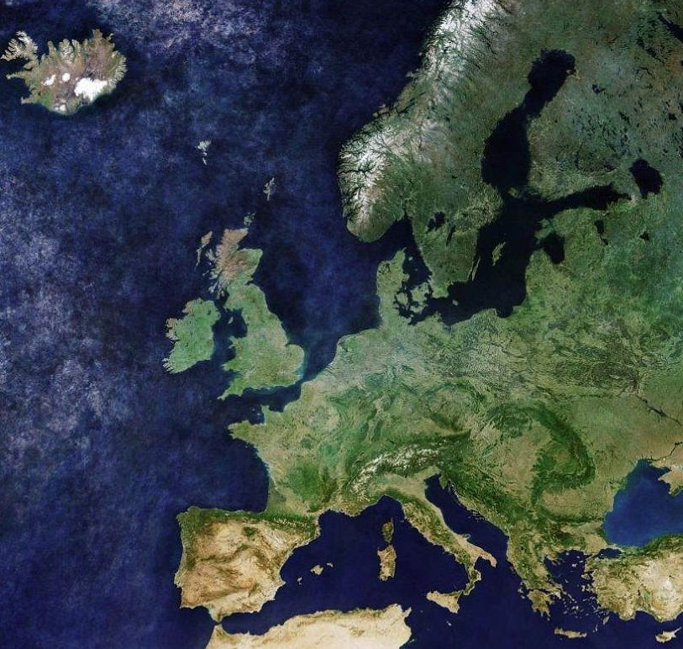
Machine Learning to Predict Climate Change at ClimateWins
Dirk Davis
9/25/25
Photo by the Copernicus Sentinel-3A weather satellite of the European Space Agency (ESA)

Slide 2
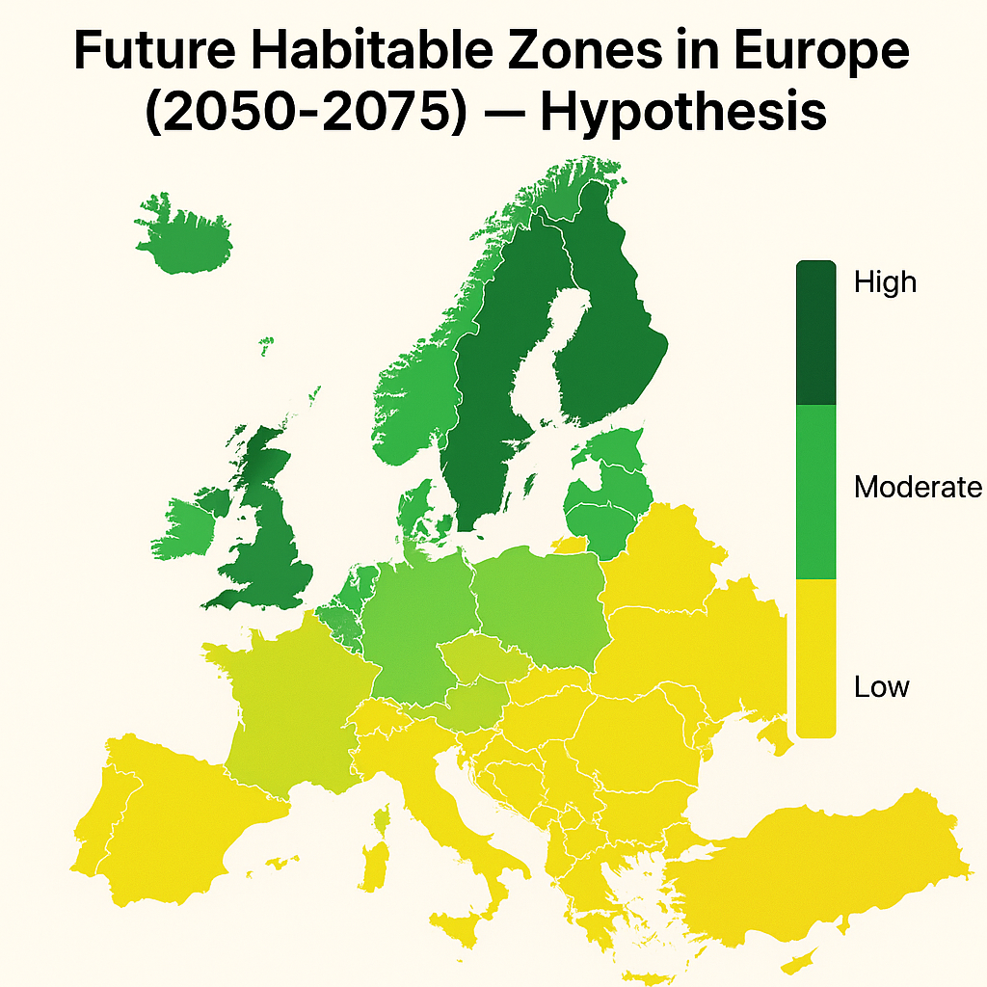
ClimateWins
Project: Climate Forecasting
Background
ClimateWins, a non-profit organization, seeks to apply machine learning (ML) to predict the consequences of climate change in Europe and beyond. It is concerned with the acceleration of extreme weather events in recent decades, believing that such
fat-tailed risk can be viably modeled and predicted with ML.
Objectives
Identify European weather patterns outside the regional norm
Determine if unusual weather patterns are increasing
Generate future weather scenarios (25-50 years) based on
historical trends
Project the safe habitable zones in Europe over next 25-50 years
AI-rendered hypothetical map by OpenAI's ChatGPT, GPT-4o model
2

Slide 3
ML models, techniques explored
Algorithms Analytical techniques
Experimentation
To develop familiarity with supervised and unsupervised learning ML models (as above), concepts and methods, the majority of ClimateWins-required tasks centered on using historical weather data (1960-2022) to predict a daily 'Pleasant' or 'Unpleasant' weather outcome (label) at each of 15 weather stations in Europe. The "Black Box" labels (answers dataset) in the binary prediction (classification) exercises were of undisclosed origin. However, the accidental discovery of 100% perfect label prediction accuracy on an imbalanced class by the Random Forests algorithm, led to an Occam's Razor explanation: the unknown-origin labels must have been created via deterministic rules and thresholds for key weather features. The Random Forests algorithm excels at reverse-engineering such type of label. Further LSTM-based poking around using a timesteps=1 setting, which achieved 96-99% classification accuracy on five different metrics, revealed the likely use of same-day weather data to create each daily label outcome at a weather station. If the labels were created as believed, then the model-specific evaluations can be limited to a specific use case (classifying deterministic rule and threshold-based labels).
KNN (K-Nearest Neighbors)
DT (Decision Tree)
RF (Random Forests)
ANN (Artificial Neural Network)
CNN (Convolutional Neural Network)
GAN (Generative Adversarial Network)
RNN (Recurrent Neural Network)
LSTM (Long Short-Term Memory as RNN variant)
Gradient descent
Adaptive moment estimation (Adam)
Data preprocessing (normalization, reshaping
one-hot encoding, subsetting)
Hyperparameter tuning (grid search, random
search, Bayesian optimization)
Regularization (dropout, L1, L2)
PCA (Principal Component Analysis)
Hierarchical clustering (dendrogram)
3

Slide 4
Thought experiments
#1 Detecting and quantifying anomalous weather trends
#2 Forecasting future weather patterns
#3 Mapping future habitable zones in Europe (future risk assessment)
“If we define what counts as ‘anomalous’ weather at each station (i.e., based on a local z-score > 2.0 in historical records), can we assume such anomalies increase over time at any of the 15+ European stations? And if so, where and when are they concentrated? Which weather features are most anomaly-prone?”
“Using a Transformer-based time series model like Autoformer, can we simulate plausible daily weather variable trajectories 25–50 years into the future for Europe, while enforcing physical constraints (temperature ranges, energy balance, etc.) to ensure realism?”
"What if we assume that the European “comfort zone”—defined as days with temperature 18–27°C, low humidity, low wind speed, and moderate sunshine—shifts northward by 2050–2075? Can we map how the number of “pleasant” days per year changes by weather station and generate a future comfort-zone map?"
4

Slide 5
Thought experiment #1: Detecting and quantifying anomalous weather trends
Hypothesis
The incidence of ‘anomalous’ weather (station-level weather feature z-score > 2.0 in historical records) has increased across Europe in recent decades, for multiple weather features.
ML model(s) and methods
Isolation Forest and/or z-score for anomaly detection; time series clustering (DBSCAN and/or k-means) over 1-year windows; Seasonal Mann-Kendall Trend Test (non-parametric); linear and non-linear (polynomial regression) trend analysis; wavelet analysis; time series decomposition (STL using LOESS); stationarization.
Additional Data needs
Expansion of temporal range of 1960-2022 daily weather data by 40 years. Optional: more features and weather stations, particularly in southern European latitudes. For more robust analysis: elevation, proximity to water bodies, gridded climate reanalysis data (ERA5/ERA20C) to enhance granularity and data uniformity.
Complexity and resources
Low complexity, lower cost.
5

Slide 6
Thought experiment #2: Forecasting future weather patterns
Hypothesis
We can simulate plausible weather scenarios 25-50 years out in time, and impose physical law-based constraints on the models to match reality.
ML model(s) and methods
Hybrid Numerical Weather Prediction (NWP) physics-based model and Transformer-based time series model (Autoformer), where NWP outputs are used as input features for the Autoformer model; synthetic data generation (GANs); time series forecasting (Prophet, ARIMA).
Additional Data needs
Expansion of temporal range of 1960-2022 daily weather data by 40 years. Optional: more features (CO2, solar activity, oceanic indices AMO/ANSO), high resolution gridded datasets (ERA5) to enhance data granularity, uniformity and comprehensiveness.
Complexity and resources
High complexity. NWP is also compute-intensive, high cost. Inaccessible to the non-profit ClimateWins' budget.
6

Slide 7
Thought experiment #3: Mapping future habitable zones in Europe
Hypothesis
The European weather "comfort zone" (days with 18–27°C temperature, low humidity, low wind speed, and moderate sunshine) will shift northward by 2050-2075.
ML model(s) and methods
Simplified, reduced-cost version of Experiment #2 for the forecasting part. Random Forests model for the classification part. Clustering, threshold-based classification. GIS (Geographic Information Systems) for integration and visualization. Scenario analysis with synthetic data inputs.
Additional Data needs
Expansion of temporal range of 1960-2022 daily weather data by 40 years. Population density, land use, sea level rise, fire hazard maps, flood risk maps. Climate thresholds for habitability (i.e., max wet-bulb temperature).
Complexity and resources
Moderate.
7

Slide 8
Conclusion
Recommendation: Thought Experiment #3 Mapping future habitable zones in Europe
Rationale: Aligns with public-facing non-profit goals, impactful, visual, action-oriented, lower cost, feasible.
Goal: Project how the frequency and spatial distribution of 'Habitable' days will shift across European regions by 2050-2075.
ML models: Hybrid NWP-Transformer (Autoformer) model, GANs, Prophet, ARIMA or LSTM (Long Short-Term Memory) as backup. Random Forests.
Data: At a minimum, 1925-2025 daily weather data (9+ weather features) at 15+ European weather stations. Habitability thresholds. GIS data. Population density, land use, sea level rise, fire hazard maps, flood risk maps. Simplified, reduced-cost version of Experiment #2 projection data.
Next steps: Acquire data > define habitability thresholds using interdisciplinary literature > run simplified version of Experiment #2 to project weather feature data > fit RF model to simulation data and habitability threshold-based y labels > summarize, evaluate, visualize results > adjust, iterate on models as needed
8

Slide 9
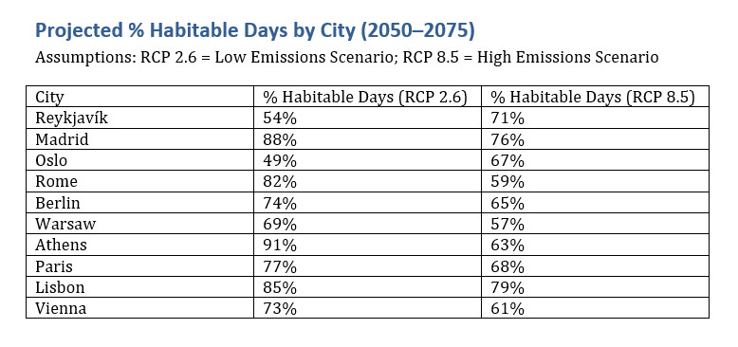

Thank You
GitHub repository for the Python
scripts and datasets used for this
project:
GitHub
Contact
ddav16psy@gmail.com
AI-rendered hypothetical table by OpenAI's ChatGPT, GPT-4o model
9

